Slide 1
Cryptovisor: A Cryptocurrency Advisor Tool
Matt Baldree
Paul Widhalm
Brandon Hill

Slide 2
Cryptocurrencies
Designed as a digital asset
1,500+ Cryptocurrencies since 2009
Coin and Token Types

Slide 3
Cryptocurrency Investing
Young Market
Volatile
5,400 Exchanges

Slide 4
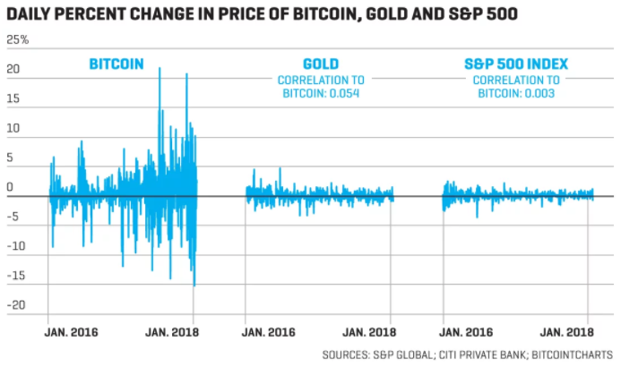
How to invest
Volatility makes the market impossible to forecast and difficult for an investor to know when to Buy, Sell or Hold cryptos

Slide 5
Cryptocurrency Investing Issues
Correlation is a major factor
Marketcap alone will not work

Slide 6
Cryptocurrency Investment Tools Available
There is not a comprehensive tool that exists
Limited in their use of market indicators

Slide 7
What Can Be Done
Comprehensive alignment of data
Statistical Analysis of the data
Utilize complex market indicators

Slide 8
Cryptovisor
We designed and partially built a cryptocurrency recommendation system
The tool can recommend a buy, sell or hold trading strategy for an investor based on market history.

Slide 9
Cryptovisor
Designed during a bull market
Design resiliency was tested and proven during the bear market

Slide 10
Cryptovisor : The Labeler
Reads in cryptocurrency exchange data
Appropriately and labels data as a buy, sell, or hold signal
A grid of parameters are used to tune the algorithm for best Sharpe Ratio.

Slide 11
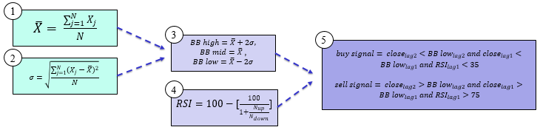
Labeler Algorithm

Slide 12
Cryptovisor : The Modeler
Reads in labeled data, separates out features from the labeled target.
A stochastic gradient boost classifier, is trained 5-fold cross validation
Features are pruned to yield simplified model is used as recommender

Slide 13
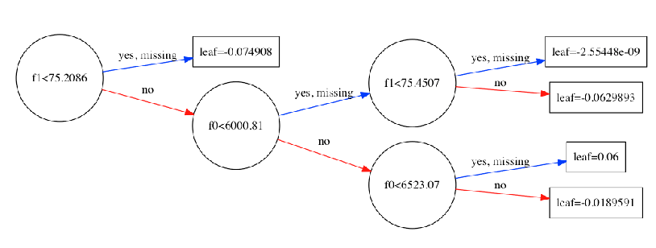
The Modeler Decision Tree

Slide 14
Accuracy
Cryptovisor is 95.5% accurate with a standard deviation of 0.54% and outperformed buy and hold in a bear market.

Slide 15
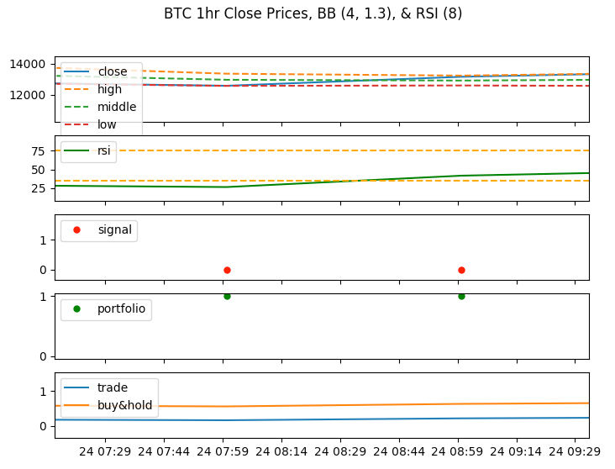
Results
labeler component.
Output charts from labeler component.

Slide 16
Results
2,000 trading signals over a three-month period
The labeler component identified:
1.31% as sell signals
2.62% as buy signals
Trading strategy for the bear market beat the buy and hold strategy in an annualized return by 1.173 and Sharpe Ratio by 0.43

Slide 17
Future Improvements
Include Sentiment Analysis
Reddit
Twitter

Slide 18
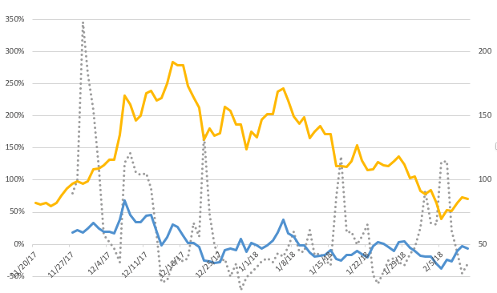
Utilizing Sentiment Analysis this tool can be further enhanced

Slide 19
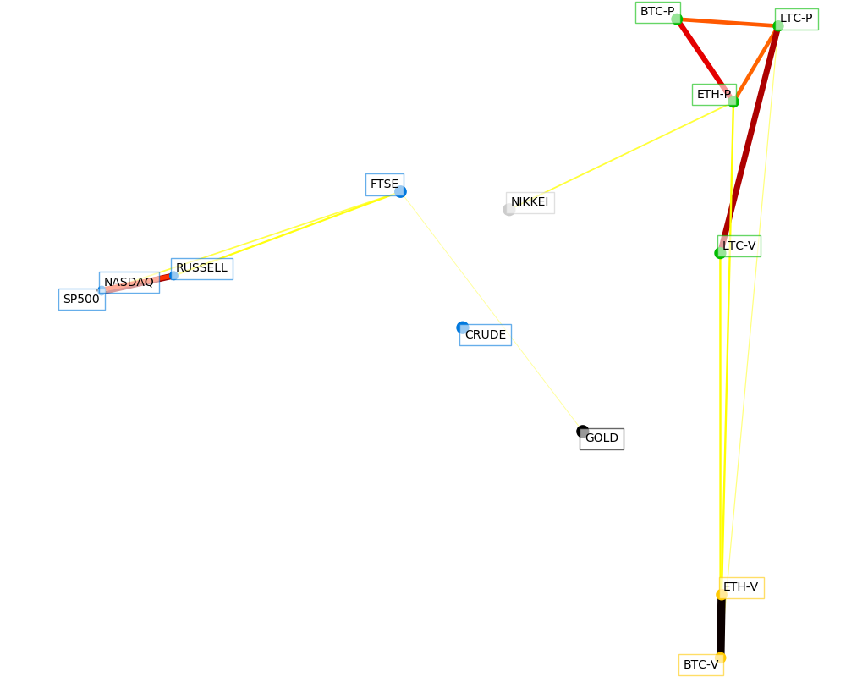
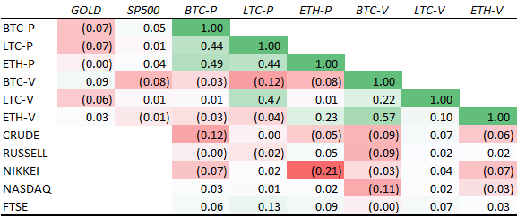
Cyrptovisor is needed because BTC is not like other assets

Slide 20
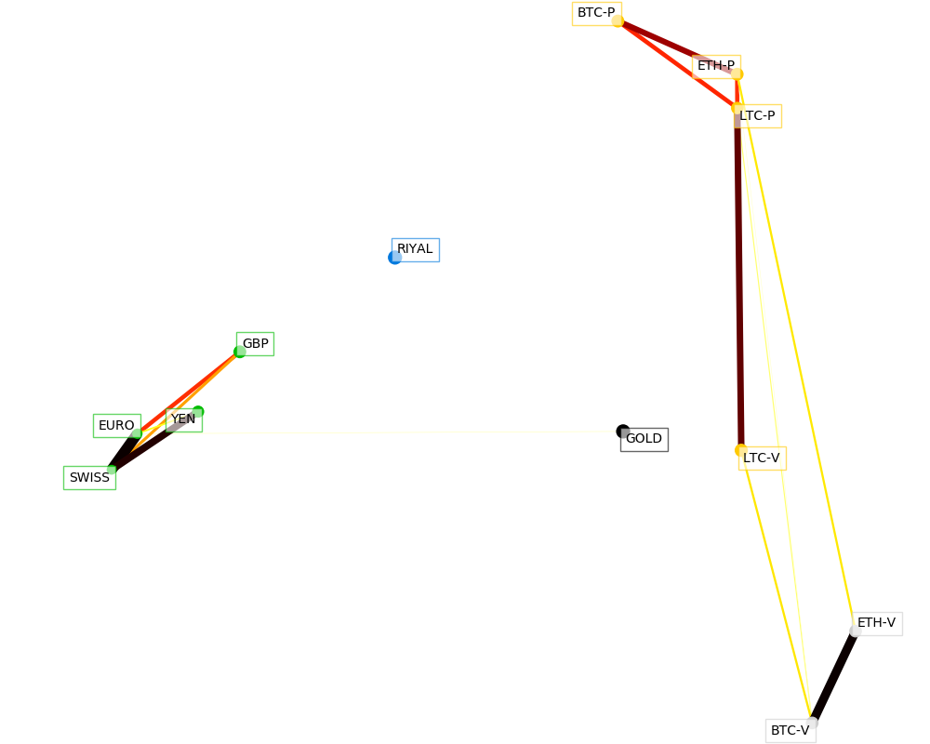
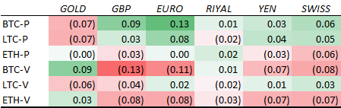
Cyrptovisor is needed because BTC is not like other Fiat

Slide 21
Conclusion
The crypto-currency market is volatile and in its infancy
Risky environment for individual investors
Cryptovisor, that is 95.5% accurate in determining the buy, sell or hold position for Bitcoin

